Slide 1
80 Years of Tradition

Slide 2
Our Agency:
Dylan Zito
Grace Hendricks
Aziz Alfadhel
Justin Roberts
Jinhee Kim

Slide 3
Executive Summary
Ragu came to life in Assunta Cantisano’s small New York garden. After coming from Italy, her pasta recipe was such a legacy that she brought it to America. Ever since, RAGÚ has been “simmered in tradition” and a staple in many households.
Now, Ragu is labeled as bland and watery compared to other brands like Prego. Prego has consistently labeled Ragu in a negative light based off of the Old World Style sauce. Now that Ragu has launched the heartier and preferred Homestyle sauce, Ragu still has the challenge of gaining back the 3 points of Market share loss.
In order to gain back market share from Prego, digital advertising efforts will focus on the introduction Ragu‘s Homestyle Six. The new sauce will have 6 different vegetables and 2 servings of veggies in every ½ serving.

Slide 4
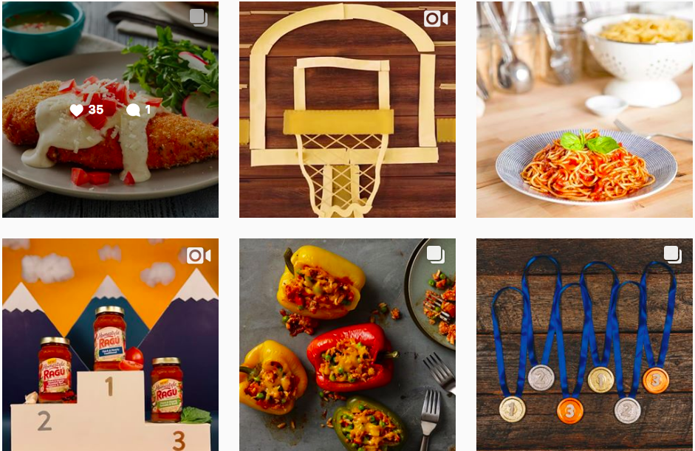
Current Digital Efforts
Ragu’s social media presence:
Facebook (1,166,049 followers), Instagram (10.7k followers), Pinterest (11,888 followers) and Twitter (37.7 followers)
Ragu has been successful on Pinterest, Facebook and Instagram to varying degrees, and does a good job of promoting itself on these platforms consistently
These platforms include recipes, seasonal ads, and use images that embellish the products’ versatility and features with colorful, high resolution imagery

Slide 5
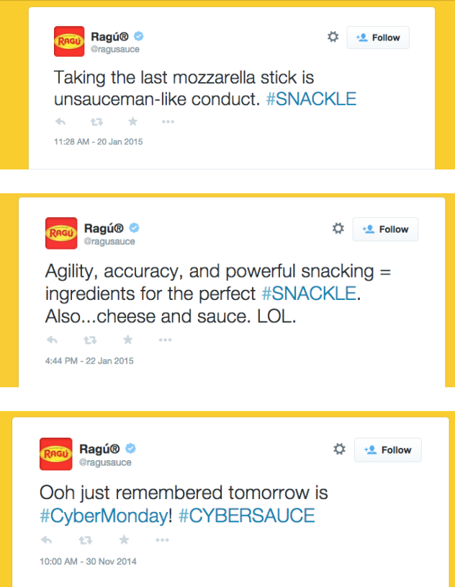
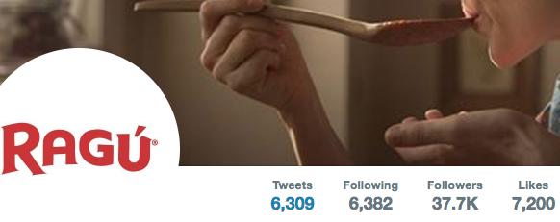
Social Presence

Slide 6
Key Consumer Target
Ragu’s key target are primarily Moms in their mid twenties to late thirties, and the kids they are raising. Ragu seeks to offer their product to mothers who want to cook healthy for their children and wish to return to their roots, and preserve the values of health and nutrition that their parents instilled in them.
While these moms might want to instill these values in their own children, Ragu recognizes how difficult it is to cook every night and make food that is appetizing and healthy for young children, and offers a solution for dinner that fits all her needs.

Slide 7
Meet Kathy!
Kathy is a 30 year old mom with a 12 year old son and 8 year old daughter. Kathy was raised in a house that avoided McDonald’s and fast food, but with Kathy’s new job she finds that ordering pizza often what her kids end up eating. Kathy knows how to cook, but after a long workday she just wants to watch TV with the kids. She is aware of Ragu, but has always thought Ragu looks a little too close to Kraft, and prefers Prego. She is open to anything that might help her cook easier meals that are also healthy, and while she prefers Prego she hasn’t actually tried Ragu.

Slide 8
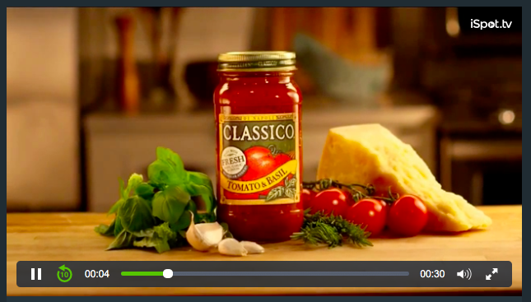
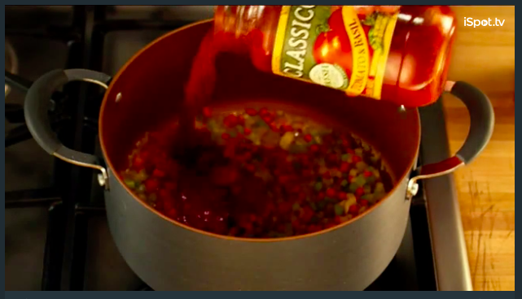
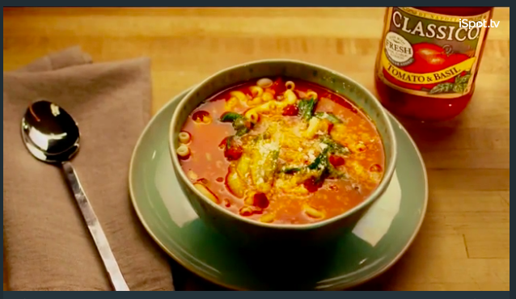
Competitive Analysis - Classico
Video Advertisement
In the commercial, Classico demonstrates how to make a meal with its product and the narration is talking about how easy it is to prepare a tasty meal.
TV commercial targets an older generation who prepares meals at home. It is a good visual action-oriented ad to make people buy their product by showing the cooking process. They also share different recipes on Facebook.

Slide 9
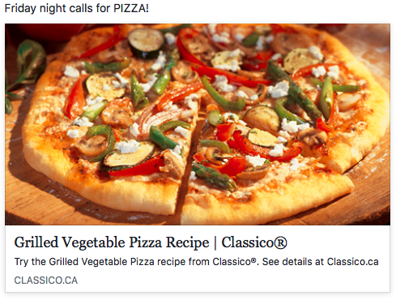
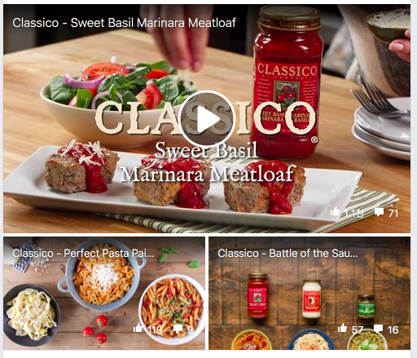
Competitive Analysis - Classico

Slide 10
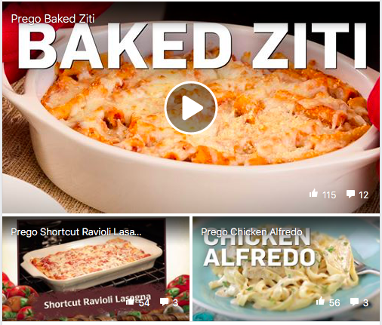
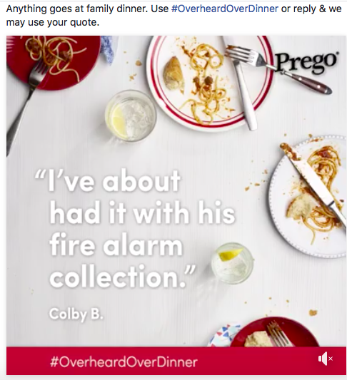
Competitive Analysis - Prego
Social Media - Facebook
- Ingredients delivery
- Recipes
- #OverheardOverDinner
They offer many different recipes and try to communicate with consumers, but they have lower engagement than RAGU

Slide 11
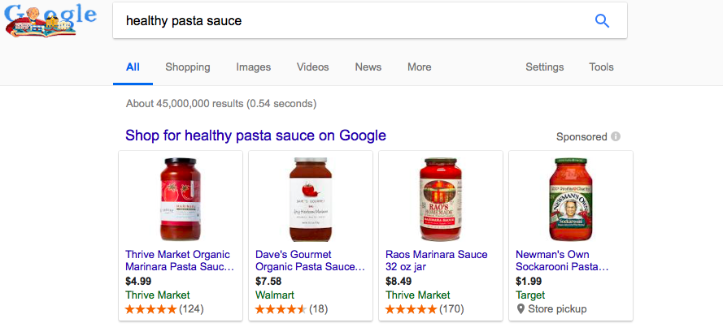
Competitive Analysis - Newman’s Own
Search Advertising
- 10 out of 13 searches
- Other products advertised on top

Slide 12
Primary Research - Survey
Surveyed 12 female millennial family pleasers
Our survey questions do NOT imply anything on ‘pasta’, ‘sauce’, or ‘healthy’ in order to get more accurate information from our participants.
- All participants are working either full time or part time
- 41% usually do grocery shoppings during weekend (Saturday or Sunday)
- 50% mentioned that they enjoy pasta as their typical week menu.
- 58% said that a successful meal is healthy, nutritious, and easy to make.

Slide 13
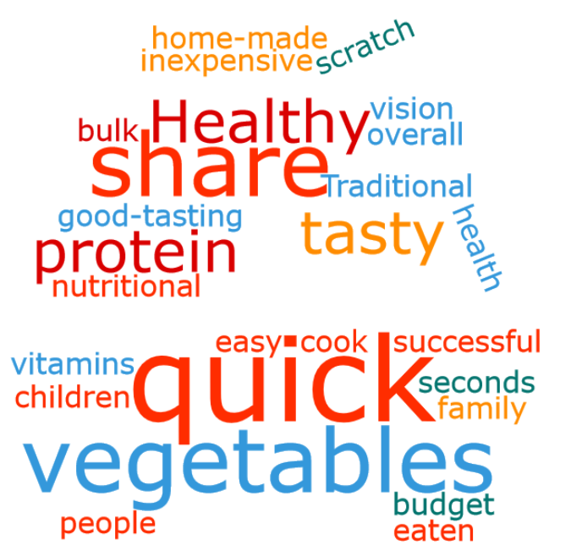
a Successful Meal
To Family Pleasers a successful meal is healthy, convenient, and enjoyed by the entire family.

Slide 14
Digital Advertising Plan

Slide 15
Objectives
Gain penetration with Millennials with kids by introducing the launch of Ragu Homestyle Garden Six
Drive awareness of new Ragu Homestyle Garden Six

Slide 16
Strategies
Show Family Pleasers that the Ragu Garden Six is Healthy and delicious choice for the entire family.
Search Ads - “What’s for dinner?” and “Healthy dinners” as key words
Display Ads - Banner and skyscraper ads will be shown across multiple channels including the Food Network.
Facebook
ads for Family Pleasers as they scroll on their newsfeed.
Facebook game – users collect the ingredients and make the sauce. At the end they are taken to the Ragu site.
360 Video to show Assunta’s garden
Spotify
30 second spots airing between 12pm and 4-5pm to engage Family Pleasers during the highest moment of relevance.
Sponsored Playlist
AR App
Introduce kids to veggies and Ragu

Slide 17
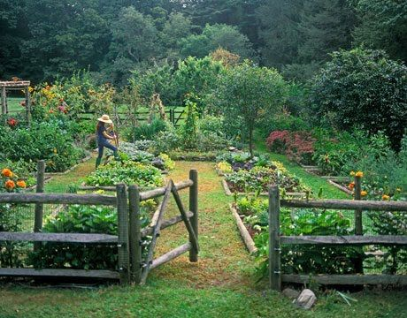
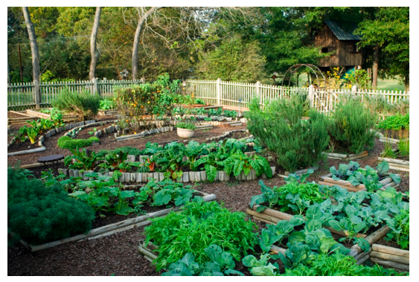
360 Video in Assunta’s Garden
This 360 video will be featured on Facebook to give users a tour of Assunta’s garden.

Slide 18
Social Display Ads

Slide 19
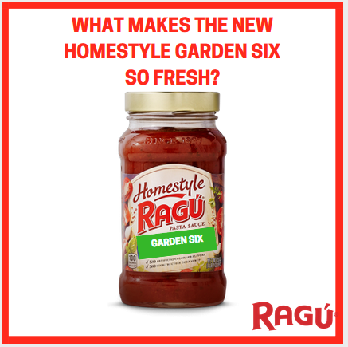
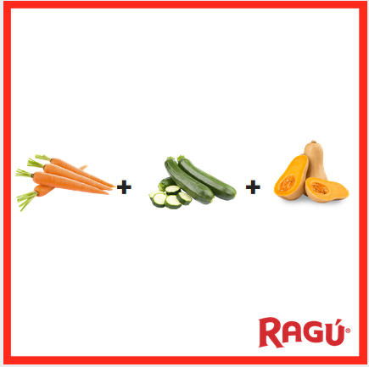
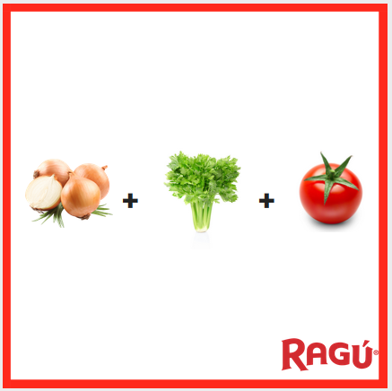
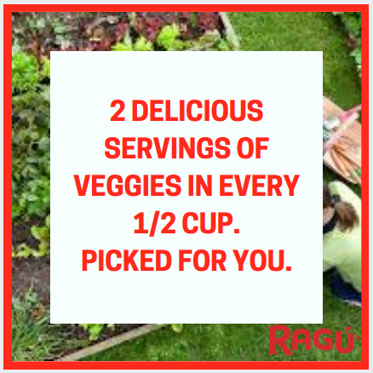
Facebook Carousel Ad
This advertisement would appear on our target audiences’ Facebook news feeds
This image allows consumers to actually see Ragu’s fresh taste.
“Picked For You” references the freshness of the vegetables in the product.

Slide 20
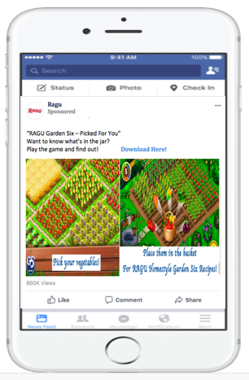
Facebook Game
Facebook Game advertising for RAGU Homestyle Garden Six will appear on RAGU’s Facebook page and newsfeed of our target audiences promoting them to download the game.
For the game, every players will get different missions to complete such as different number of veggies and different types of veggies and the veggies in the game will be the ones used in Garden Six sauce. Once they complete the mission by picking up the veggies the game will take them to RAGU website automatically.
We want to emphasize that the RAGU Garden Six is healthy fresh, and picked for you. So we used animated veggies for the healthy and ‘freshness’ and connected ‘picked for you’ concept through the mission where people have to pick their veggies.
This will raise awareness of RAGU Garden Six among our target audiences and will be spread easily and quickly though share function in Facebook.

Slide 21
Banner Ads

Slide 22
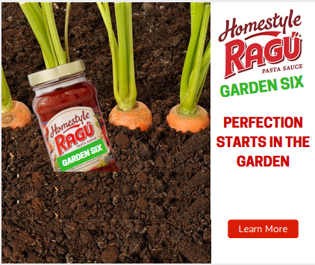
The ads will resonate with “family pleasers” who want to see their children happy and healthy. This ad takes place in a garden. The Ragu Garden Six sauce is growing along with the vegetables, implying that the sauce is also nutritious and fresh. The copy reads “Picked For You” referencing the freshness of the vegetables in the product.
These banner ads follow the best practices with the eye-catching pictures, compelling copy, and a call-to-action button that people can click to find out more about the product.

Slide 25
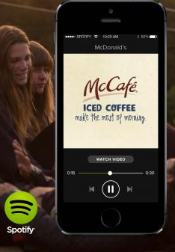
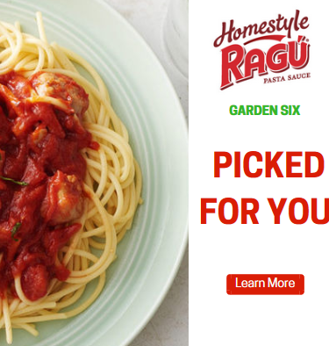
Spotify
30 second Spotify ad to introduce the new sauce
Chopping of food, the sizzle in the pan, the stirring of the sauce, the slurp of a noodle, “mmmmm”
“Six veggies in one jar. Try the new Ragu Homestyle Six. Packed with six garden veggies.”
Sponsored Spotify playlist

Slide 26
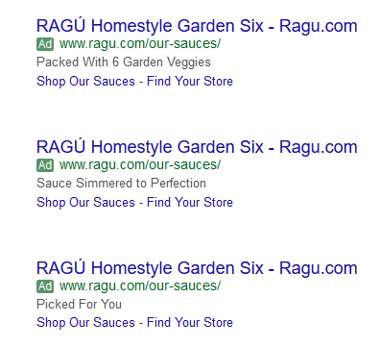
Search Ads
“What’s for dinner?” and “Healthy dinners” are both popular searches during dinner time. RAGÚ search ads will show up with recipes and the new Homestyle Six Sauce. The goal is to get Family Pleasers to start thinking of Ragu as an option for dinner before they get to the store.

Slide 27
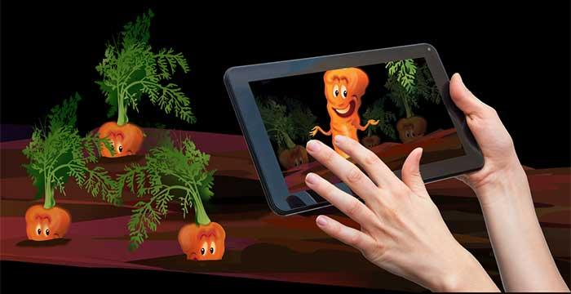
Augmented Reality Game
App available for download online or from scanning the sauce label
Children can play the game in the kitchen while their mothers make dinner
Great way to get kids involved at dinnertime
The AR game would feature 6 veggie characters
The characters educate kids about the nutrition and make vegetables more approachable

Slide 28
KPIs
Banner Ads:
- CTR
- impressions
Social Media:
- Engagement: Shares, likes, and impressions
- CTR

